Slide 1


Discrete-Time Signals and Systems
Chapter Intended Learning Outcomes:
(i) Understanding deterministic and random discrete-time
signals and ability to generate them
(ii) Ability to recognize the discrete-time system properties,
namely, memorylessness, stability, causality, linearity and
time-invariance
(iii) Understanding discrete-time convolution and ability to
perform its computation
(iv) Understanding the relationship between difference
equations and discrete-time signals and systems
Y. Chen
Page 1
Semester A, 2022-2023

Slide 2
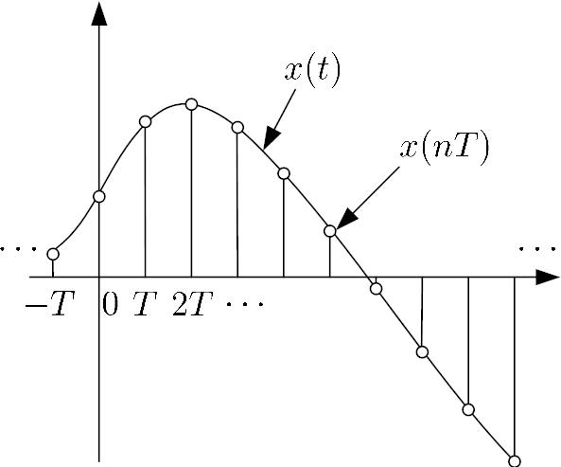
Discrete-Time Signal
. Discrete-time signal can be generated using a computing
software such as MATLAB
. It can also be obtained from sampling continuous-time
signals in real world
t
Fig.3.1: Discrete-time signal obtained from analog signal
Y. Chen
Page 2
Semester A, 2022-2023

Slide 3






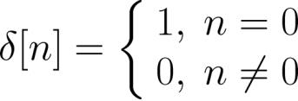
. The discrete-time signal
is equal to only at the
(3.1)
sampling interval of
,
where is called the sampling period
. is a sequence of numbers,
, with
being the time index
Basic Sequences
. Unit Sample (or Impulse)
(3.2)
Y. Chen
Page 3
Semester A, 2022-2023

Slide 4




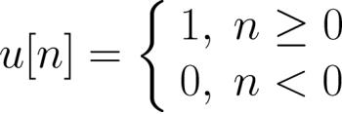



It is similar to the continuous-time unit impulse which is
defined in (2.10)-(2.12)
is simpler than because it is well defined for all
while is not defined at
. Unit Step
(3.3)
It is similar to to the continuous-time of (2.13)
is well defined for all but is not defined .
Y. Chen
Page 4
Semester A, 2022-2023

Slide 5
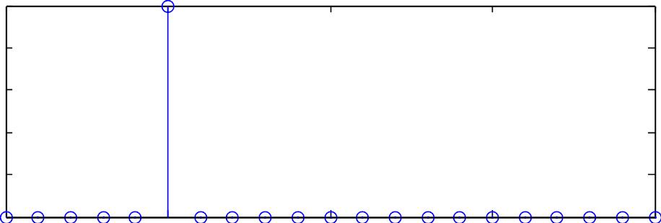
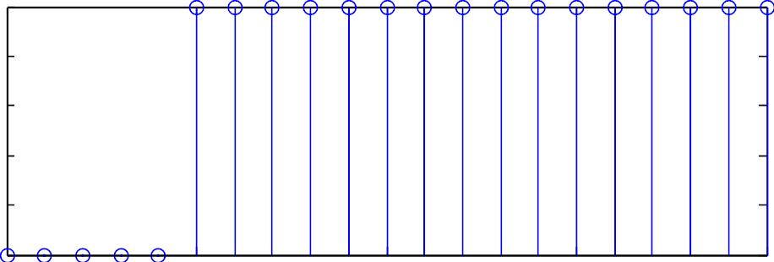


1
0.8
0.6
0.4
0.2
0
-5
0
5
10
15
n
1
0.8
0.6
0.4
0.2
0
-5
0
5
10
15
n
Fig.3.2:Unit sample and unit step
Y. Chen
Page 5
Semester A, 2022-2023

Slide 6

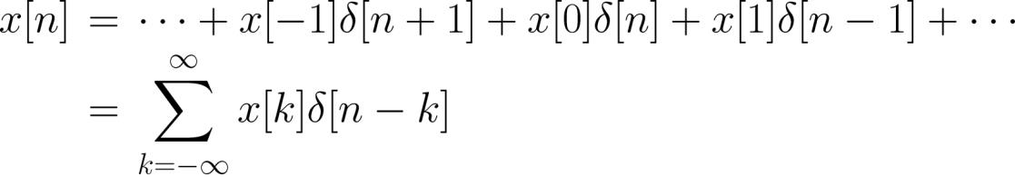

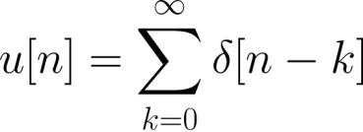

is an important function because it serves as the
building block of any discrete-time signal :
(3.4)
For example, can be expressed in terms of as:
(3.5)
Conversely, we can use to represent :
(3.6)
Y. Chen
Page 6
Semester A, 2022-2023

Slide 7
Introduction to MATLAB
. MATLAB stands for ”Matrix Laboratory”
. Interactive matrix-based software for numerical and
symbolic computation in scientific and engineering
applications
. Its user interface is relatively simple to use, e.g., we can
use the help command to understand the usage and
syntax of each MATLAB function
. Together with the availability of numerous toolboxes,
there are many useful and powerful commands for
various disciplines
. MathWorks offers MATLAB to C conversion utility
. Similar packages include Maple and Mathematica
Y. Chen
Page 7
Semester A, 2022-2023

Slide 8











Discrete-Time Signal Generation using MATLAB
A deterministic discrete-time signal
generating model with known functional form:
satisfies a
(3.7)
where is a function of parameter vector and time
index . That is, given and , can be produced
e.g., the time-shifted unit sample
function , where the parameter is
and unit step
e.g., for an exponential function , we have
where is the decay factor and is the time shift
e.g., for a sinusoid
, we have
Y. Chen
Page 8
Semester A, 2022-2023

Slide 9





Example 3.1
Use MATLAB to generate a discrete-time sinusoid of the
form:
with ,
,
and
, which has a duration of
21 samples.
We can generate by using the following MATLAB code:
N=21;
A=1;
w=0.3;
p=1;
%number of samples is 21
%tone amplitude is 1
%frequency is 0.3
%phase is 1
for n=1:N
x(n)=A*cos(w*(n-1)+p); %time index should be >0
end
Y. Chen
Page 9
Semester A, 2022-2023

Slide 10
Note that xis a vector and its index should be at least 1.
Alternatively, we can also use:
N=21;
A=1;
w=0.3;
p=1;
%number of samples is 21
%tone amplitude is 1
%frequency is 0.3
%phase is 1
n=0:N-1;
%define time index vector
x=A.*cos(w.*n+p); %first time index is also 1
Both give
x =
Columns 1 through 7
0.5403 0.2675 -0.0292 -0.3233 -0.5885 -0.8011 -0.9422
Columns 8 through 14
-0.9991 -0.9668 -0.8481 -0.6536 -0.4008 -0.1122 0.1865
Columns 15 through 21
Y. Chen
Page 10
Semester A, 2022-2023

Slide 11


0.4685 0.7087 0.8855 0.9833 0.9932 0.9144 0.7539
Which approach is better? Why?
To plot , we can either use the commands stem(x) and
plot(x)
If the time index is not specified, the default start time is
Nevertheless, it is easy to include the time index vector in
the plotting command
e.g., Using stemto plot with the correct time index:
n=0:N-1;
stem(n,x)
%n is vector of time index
%plot x versus n
Similarly, plot(n,x)can be employed to show
Y. Chen
Page 11
Semester A, 2022-2023

Slide 12
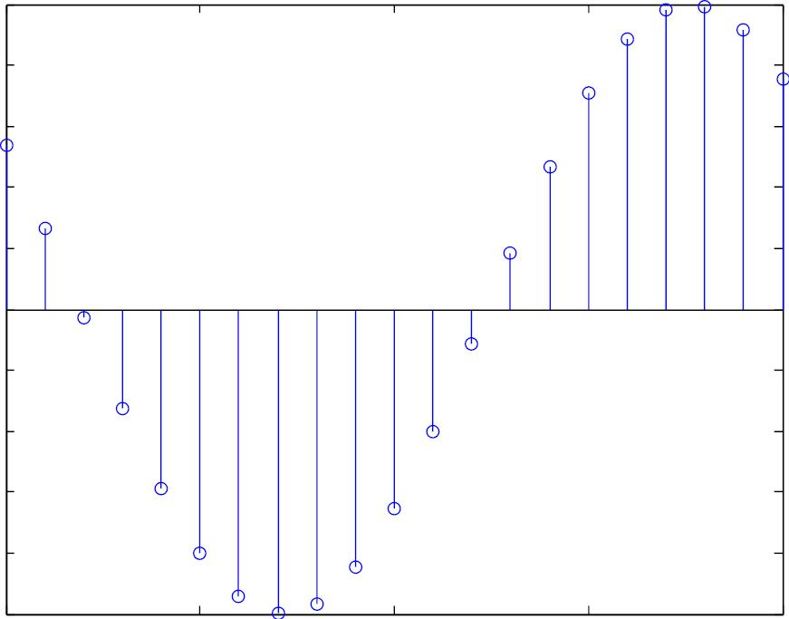
1
0.8
0.6
0.4
0.2
0
-0.2
-0.4
-0.6
-0.8
-1
0
5
10
n
15
20
Fig.3.3: Plot of discrete-time sinusoid using stem
Y. Chen
Page 12
Semester A, 2022-2023

Slide 13
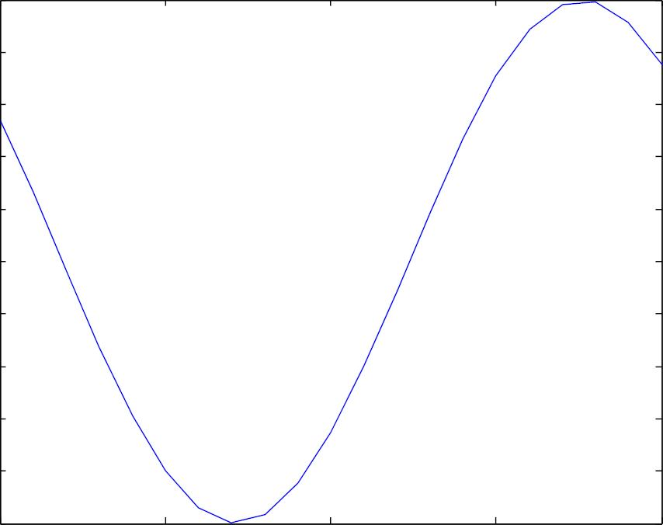
1
0.8
0.6
0.4
0.2
0
-0.2
-0.4
-0.6
-0.8
-1
0
5
10
n
15
20
Fig.3.4: Plot of discrete-time sinusoid using plot
Y. Chen
Page 13
Semester A, 2022-2023

Slide 14




Apart from deterministic signal, random signal is another
importance signal class. It cannot be described by
mathematical expressions like deterministic signals but is
characterized by its probability density function (PDF).
MATLAB has commands to produce two common random
signals, namely, uniform and Gaussian (normal) variables.
A uniform integer sequence whose values are uniformly
distributed between 0 and , can be generated using:
(3.8)
where and are very large positive integers, is the
reminder of dividing
by
Each admissible value of
probability of occurrence of approximately
has the same
,
Y. Chen
Page 14
Semester A, 2022-2023

Slide 15


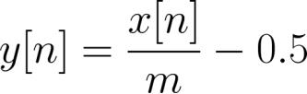
We also need an initial integer or seed, say,
for starting the generation of
(3.8) can be easily modified by properly scaling and shifting
e.g., a random number which is uniformly between –0.5
and 0.5, denoted by , is obtained from :
(3.9)
The MATLAB command rand is used to generate random
numbers which are uniformly between 0 and 1
e.g., each realization of stem(0:20,rand(1,21)) gives a
distinct and random sequence, with values are bounded
between 0 and 1.
Y. Chen
Page 15
Semester A, 2022-2023

Slide 16
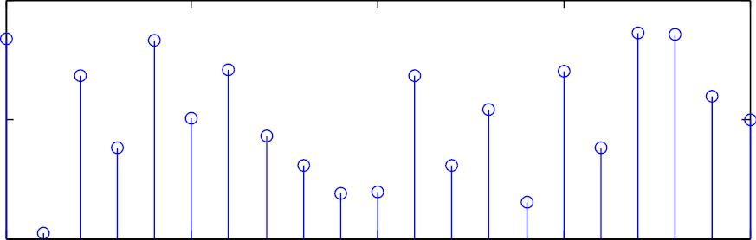
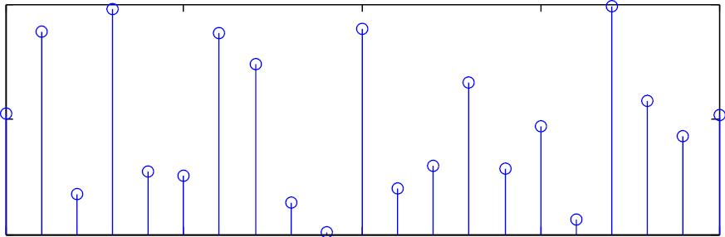
1
0.5
0
1
0
5
10
n
15
20
0.5
0
0
5
10
n
15
20
Fig.3.5: Uniform number realizations using rand
Y. Chen
Page 16
Semester A, 2022-2023

Slide 17
Example 3.2
Use MATLAB to generate a sequence of 10000 random
numbers uniformly distributed between –0.5 and 0.5 based
on the command rand. Verify its characteristics.
According to (3.9), we use u=rand(1,10000)-0.5 to
generate the sequence
To verify the uniform distribution, we use hist(u,10),
which bins the elements of u into 10 equally-spaced
containers
We see all numbers are bounded between –0.5 and 0.5,
and each bar which corresponds to a range of 0.1, contains
approximately 1000 elements.
Y. Chen
Page 17
Semester A, 2022-2023

Slide 18
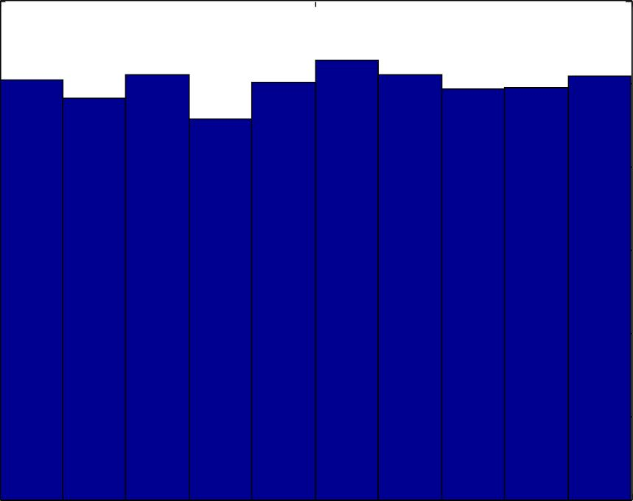
1200
1000
800
600
400
200
0
-0.5
0
0.5
Fig.3.6: Histogram for uniform sequence
Y. Chen
Page 18
Semester A, 2022-2023

Slide 19

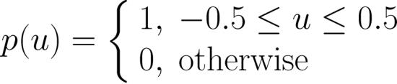

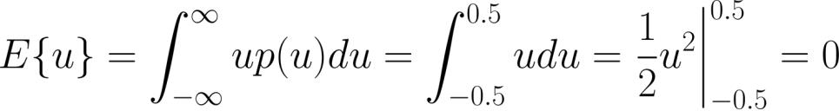
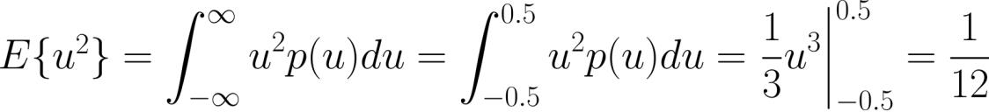
On the other hand, the PDF of u, denoted by , is
such that
. The theoretical mean and power of
u, are computed as
and
Average value and power of u in this realization are
computed using mean(u) and mean(u.*u), which give 0.002
and 0.0837, and they align with theoretical calculations
Y. Chen
Page 19
Semester A, 2022-2023

Slide 20




Gaussian numbers can be generated from the uniform
variables
Given a pair of independent random numbers uniformly
distributed between 0 and 1,
, a pair of independent
Gaussian numbers , which have zero mean and unity
power (or variance), can be generated from:
and
(3.10)
(3.11)
The MATLAB command is randn. Equations (3.10) and
(3.11) are known as the Box-Mueller transformation.
e.g., each realization of stem(0:20,randn(1,21)) gives a
distinct and random sequence, whose values are fluctuating
around zero.
Y. Chen
Page 20
Semester A, 2022-2023

Slide 21
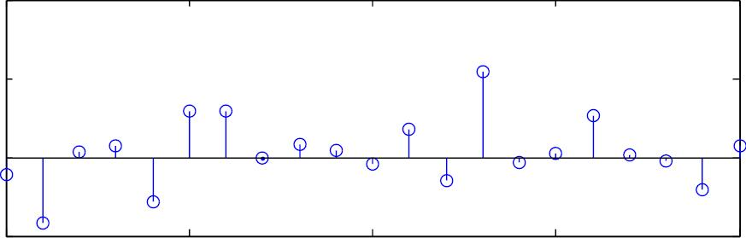
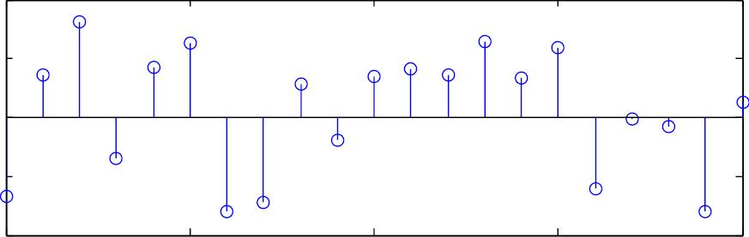
4
2
0
-2
0
5
10
n
15
20
2
1
0
-1
-2
0
5
10
n
15
20
Fig.3.7: Gaussian number realizations using randn
Y. Chen
Page 21
Semester A, 2022-2023

Slide 22



Example 3.3
Use the MATLAB command randn to generate a zero-mean
Gaussian sequence of length 10000 and unity power. Verify
its characteristics.
In theory, each Gaussian variable should have zero mean
and unity power, i.e.,
The variance can be easily shown to be:
The standard deviation is defined as:
Y. Chen
Page 22
Semester A, 2022-2023

Slide 23



Note that 99.7% of the Gaussian data are within
We use w=randn(1,10000) to generate the sequence and
hist(w,50) to show its distribution
The distribution aligns with Gaussian variables which is
indicated by the bell shape
The empirical mean and power of w computed using
mean(w) and mean(w.*w) are
and 1.0028
We see that most of the values are within with
Y. Chen
Page 23
Semester A, 2022-2023

Slide 24
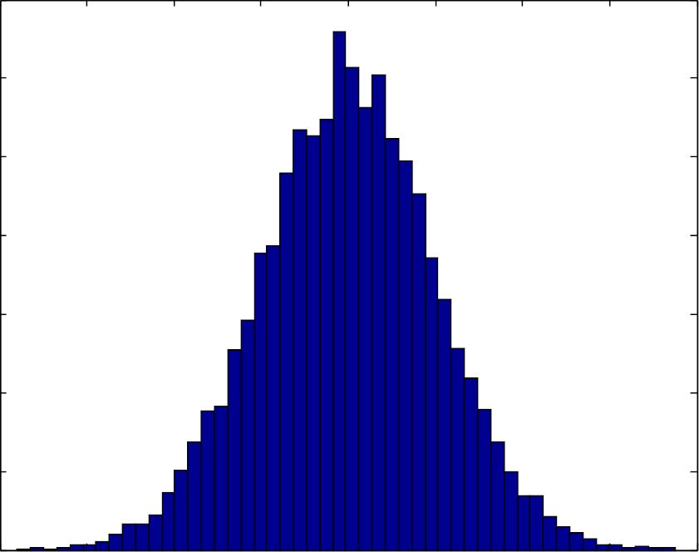
700
600
500
400
300
200
100
0
-4
-3
-2
-1
0
1
2
3
4
Fig.3.8: Histogram for Gaussian sequence
Y. Chen
Page 24
Semester A, 2022-2023

Slide 25





Discrete-Time Systems
A discrete-time system is an operator which maps an
input sequence into an output sequence :
(3.12)
. Memoryless: at time depends only on at time
Are they memoryless systems?
y[n]=(x[n])²
y[n]=x[n]+ x[n-2]
. Linear: obey principle of superposition, i.e., if
and
then
(3.13)
Y. Chen
Page 25
Semester A, 2022-2023

Slide 26
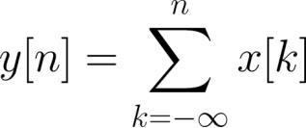


Example 3.4
Determine whether the following system with input and
output , is linear or not:
A standard approach to determine the linearity of a system
is given as follows. Let
with
If
, then the system is linear. Otherwise,
Y. Chen
Page 26
Semester A, 2022-2023

Slide 27
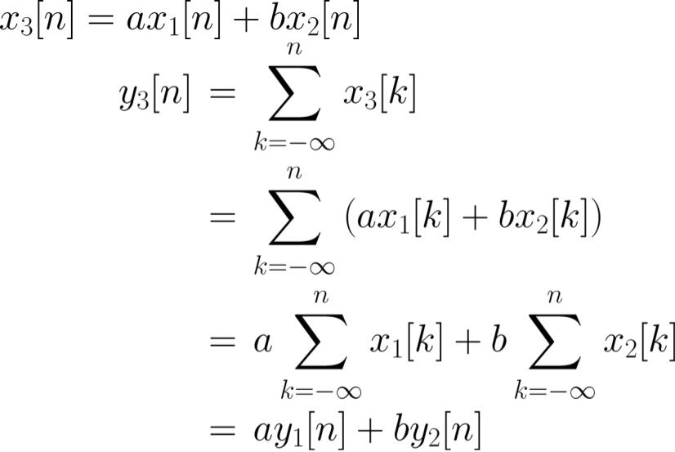




the system is nonlinear.
Assigning
, we have:
Note that the outputs for and are
and
As a result, the system is linear
Y. Chen
Page 27
Semester A, 2022-2023

Slide 28



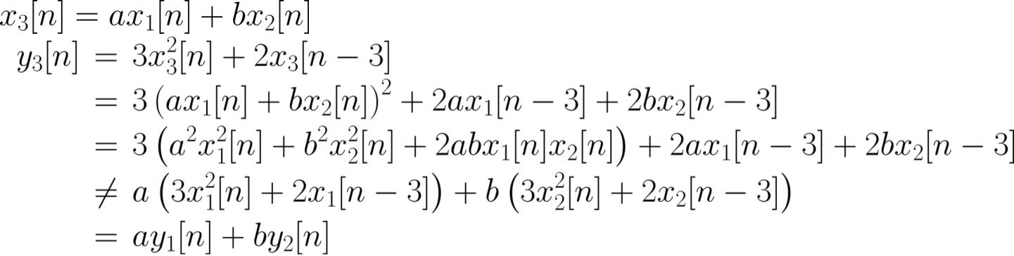
Example 3.5
Determine whether the following system with input and
output , is linear or not:
The system outputs for
and
and
are
. Assigning
, its system output is then:
As a result, the system is nonlinear.
Y. Chen
Page 28
Semester A, 2022-2023

Slide 29

. Time-Invariant: a time-shift of input causes a
corresponding shift in output, i.e., if
then
(3.14)
Example 3.6
Determine whether the following system with input and
output , is time-invariant or not:
A standard approach to determine the time-invariance of a
system is given as follows.
Y. Chen
Page 29
Semester A, 2022-2023

Slide 30



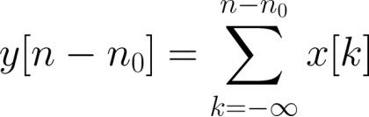
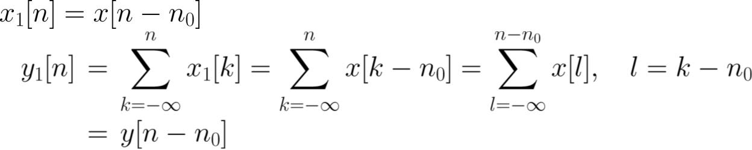
Let
with
If
, then the system is time-invariant.
Otherwise, the system is time-variant.
From the given input-output relationship,
is:
Let
, its system output is:
As a result, the system is time-invariant.
Y. Chen
Page 30
Semester A, 2022-2023

Slide 31

Example 3.7
Determine whether the following system with input and
output , is time-invariant or not:
From the given input-output relationship,
form:
is of the
Let
, its system output is:
As a result, the system is time-variant.
Y. Chen
Page 31
Semester A, 2022-2023

Slide 32




. Causal: output at time depends on input up to
time
For linear time-invariant (LTI) systems, there is an
alternative definition. A LTI system is causal if its impulse
response satisfies:
(3.15)
Are they causal systems?
y[n]=x[n]+x[n+1]
y[n]=x[n]+x[n-2]
. Stable: a bounded input
(
) produces a
bounded output (
)
Y. Chen
Page 32
Semester A, 2022-2023

Slide 33
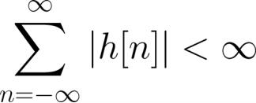


For LTI system, stability also corresponds to
(3.16)
Are they stable systems?
y[n]=x[n]+x[n+1]
y[n]=1/x[n]
Note that these five definitions hold for continuous-time
systems. That is, we just need to replace the discrete index
to the continuous . In particular, for stability,
is changed to
.
Y. Chen
Page 33
Semester A, 2022-2023

Slide 34
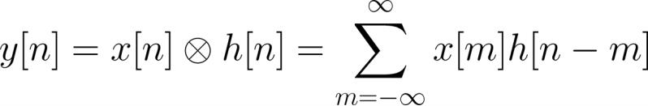

Convolution
The input-output relationship for a LTI system is
characterized by convolution:
(3.17)
which is similar to (2.23)
(3.17) is simpler as it only needs additions and
multiplications
specifies the functionality of the system
Y. Chen
Page 34
Semester A, 2022-2023

Slide 35
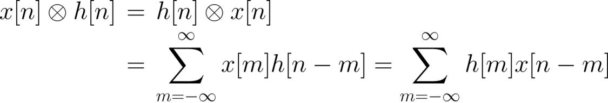
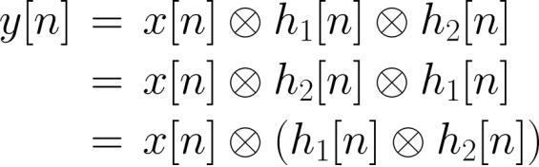
. Commutative
(3.18)
And
(3.19)
Y. Chen
Page 35
Semester A, 2022-2023

Slide 36
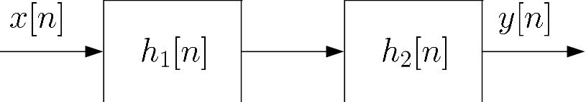
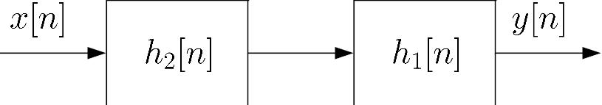
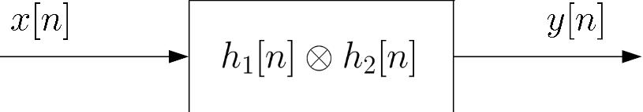
Fig.3.9: Commutative property of convolution
Y. Chen
Page 36
Semester A, 2022-2023

Slide 37
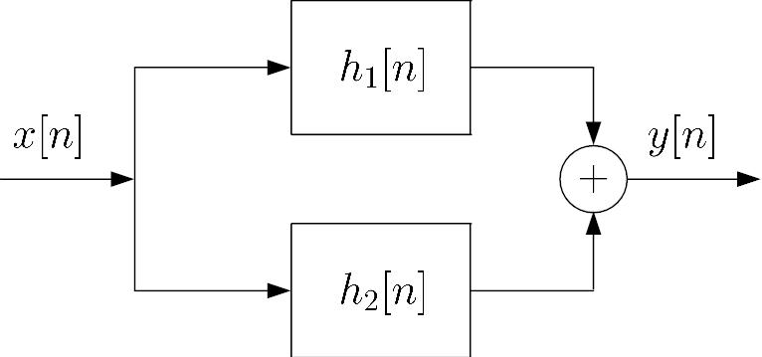
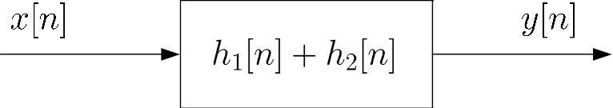
. Linearity
(3.20)
Fig.3.10: Linear property of convolution
Y. Chen
Page 37
Semester A, 2022-2023

Slide 38


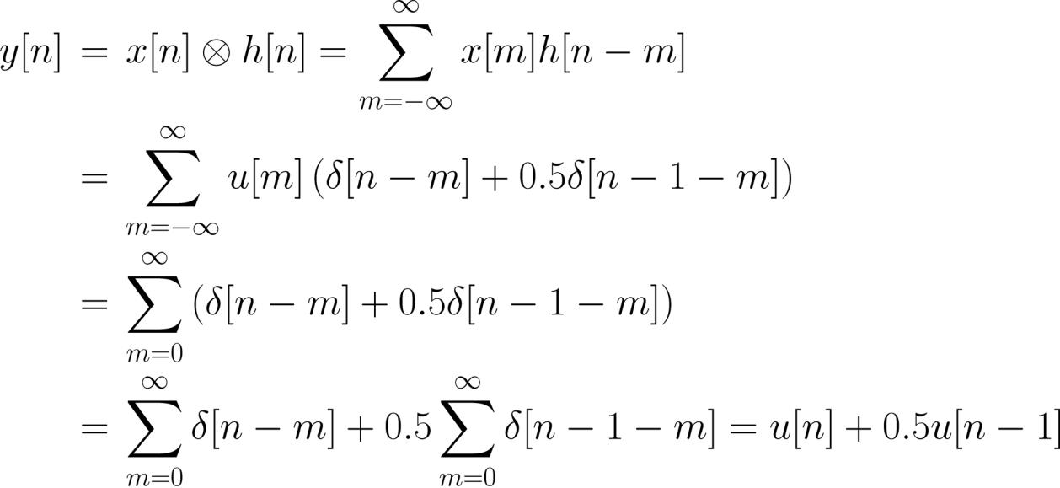
Example 3.8
Compute the output
LTI system impulse response is
Determine the stability and causality of system.
Using (3.17), we have:
if the input is
and the
.
Y. Chen
Page 38
Semester A, 2022-2023

Slide 39
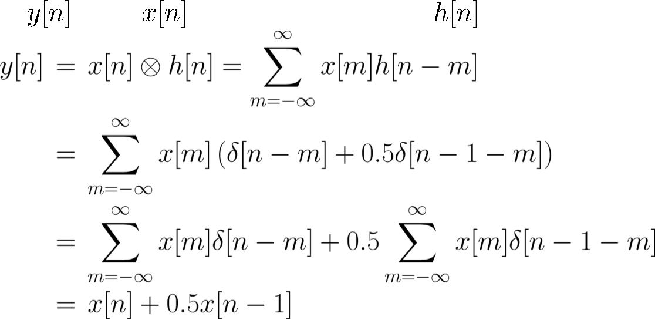



Alternatively, we can first establish the general relationship
between and with the specific and (3.4):
Substituting
Since
yields the same .
and
for
the system is stable and causal.
Y. Chen
Page 39
Semester A, 2022-2023

Slide 40



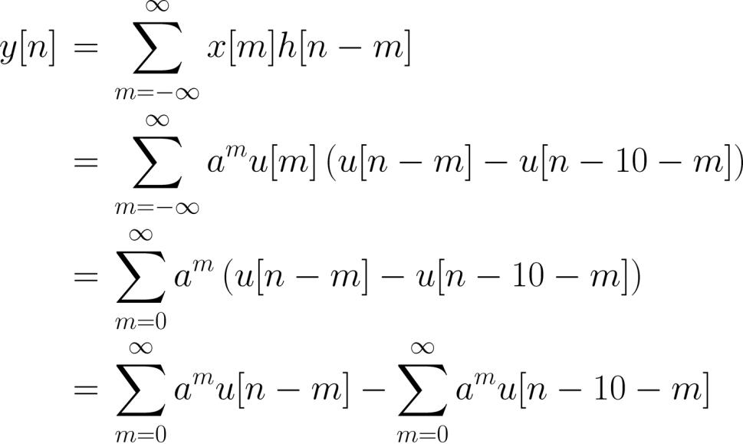
Example 3.9
Compute the output if the input is
LTI system impulse response is
Determine the stability and causality of system.
and the
.
Using (3.17), we have:
Y. Chen
Page 40
Semester A, 2022-2023

Slide 41



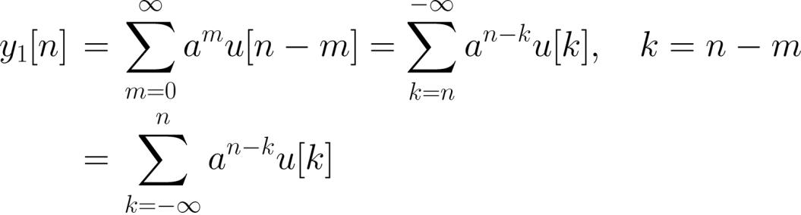




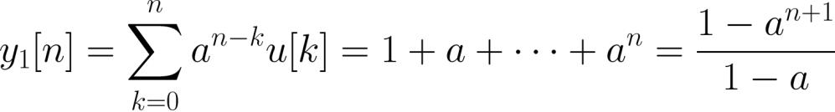
Let
and
such that
. By employing a change of
variable, is expressed as
Since
for ,
for . For
, is:
That is,
Y. Chen
Page 41
Semester A, 2022-2023

Slide 42
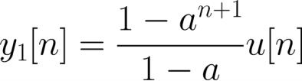

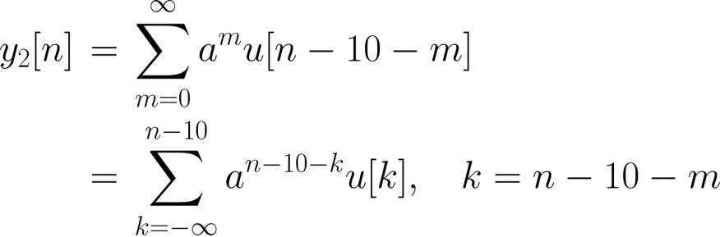




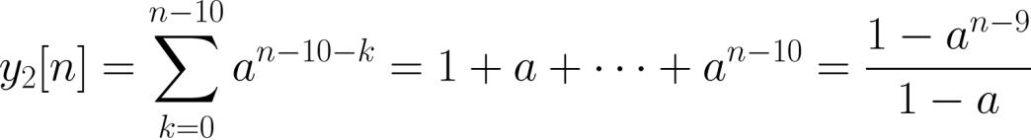
Similarly, is:
Since
for ,
for
. For
, is:
That is,
Y. Chen
Page 42
Semester A, 2022-2023

Slide 43
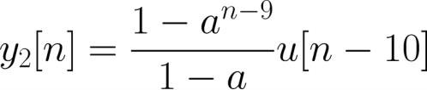
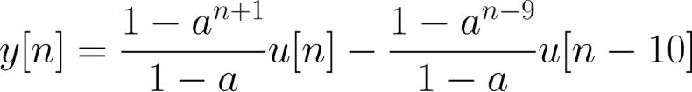
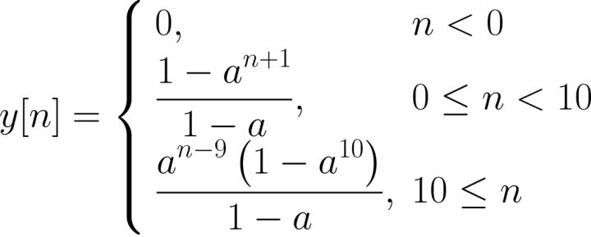

Combining the results, we have:
or
Since
, the system is stable.
for .
Moreover, the system is causal because
Y. Chen
Page 43
Semester A, 2022-2023

Slide 44

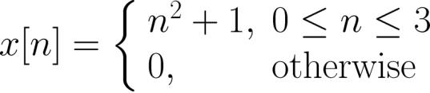
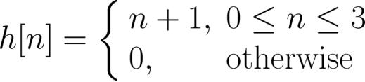








Example 3.10
Determine
where and are
and
Here, the lengths of both
precisely,
and
and
are finite. More
,
,
,
,
,
,
while all other and have zero
values.
Y. Chen
Page 44
Semester A, 2022-2023

Slide 45
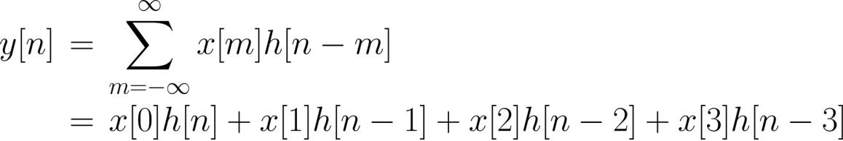
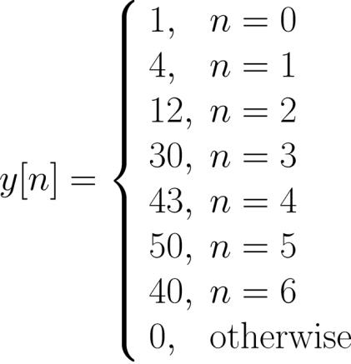
We still use (3.17) but now it reduces to a finite summation:
By considering the non-zero values of , we obtain:
Y. Chen
Page 45
Semester A, 2022-2023

Slide 46
Alternatively, for finite-length discrete-time signals, we can
use the MATLAB command conv to compute the convolution
of finite-length sequences:
n=0:3;
x=n.^2+1;
h=n+1;
y=conv(x,h)
The results are
y = 1 4 12 30 43 50 40
As the default starting time indices in both h and x are 1,
we need to determine the appropriate time index for y
Y. Chen
Page 46
Semester A, 2022-2023

Slide 47

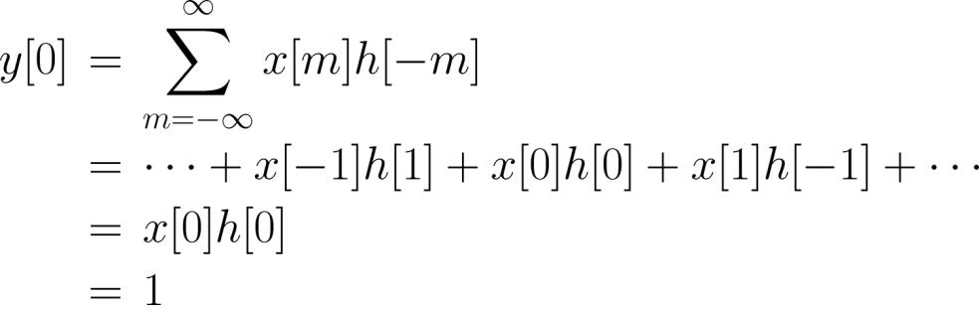




The correct index can be obtained by computing one value
of using (3.17). For simplicity, we may compute :
In general, if the lengths of and are and ,
respectively, the length of
is
.
Y. Chen
Page 47
Semester A, 2022-2023

Slide 48
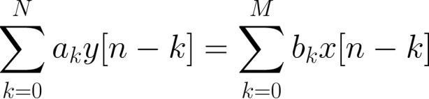


Linear Constant Coefficient Difference Equations
For a LTI system, its input and output are related via
a th-order linear constant coefficient difference equation:
(3.21)
which is useful to check whether a system is both linear and
time-invariant or not
Example 3.11
Determine if the following input-output relationships
correspond to LTI systems:
(a)
(b)
(c)
Y. Chen
Page 48
Semester A, 2022-2023

Slide 49






We see that (a) corresponds to a LTI system with
, , and
For (b), we reorganize the equation as:
which agrees with (3.21) when
,
and
. Hence (b) also corresponds to a LTI system
For (c), it does not correspond to a LTI system because
and are not linear in the equation
Note that if a system cannot be fitted into (3.21), there are
three possibilities: linear and time-variant; nonlinear and time-invariant; or nonlinear and time-variant
Y. Chen
Page 49
Semester A, 2022-2023

Slide 50




Example 3.12
Compute the impulse response for a LTI system which is
characterized by the following difference equation:
Expanding (3.17) as
we can easily deduce that only and are nonzero. That
is, the impulse response is:
Y. Chen
Page 50
Semester A, 2022-2023

Slide 51





The difference equation is also useful to generate the
system output and input.
Assuming that , is computed as:
(3.22)
Assuming that , can be obtained from:
(3.23)
Y. Chen
Page 51
Semester A, 2022-2023

Slide 52


Example 3.13
Given a LTI system with difference equation of
, compute the system output
for
with an input of
. It is assumed
that
The MATLAB code is:
.
N=50; %data length is N+1
y(1)=1; %compute y[0], only x[n] is nonzero
for n=2:N+1
y(n)=0.5*y(n-1)+2; %compute y[1],y[2],…,y[50]
%x[n]=x[n-1]=1 for n>=1
end
n=[0:N];
%set time axis
stem(n,y);
Y. Chen
Page 52
Semester A, 2022-2023

Slide 53

system output
4
3.5
3
2.5
2
1.5
1
0.5
0
0
10
20
30
40
50
n
Fig.3.11: Output generation with difference equation
Y. Chen
Page 53
Semester A, 2022-2023

Slide 54


Alternatively, we can use the MATLAB command filter by
rewriting the equation as:
The corresponding MATLAB code is:
x=ones(1,51);
a=[1,-0.5];
b=[1,1];
%define input
%define vector of a_k
%define vector of b_k
y=filter(b,a,x); %produce output
stem(0:length(y)-1,y)
The x is the input which has a value of 1 for
, while
a and b are vectors which contain and , respectively.
Y. Chen
Page 54
Semester A, 2022-2023

